Slide 1
CNN-SLAM Real-time dense monocular SLAM with learned depth prediction
Reading Note

Slide 2
Problems to solve for Monocular
Absence absolute scale of depth.
High-uncertainty pose and depths within low-textured regions.
Failed under pure rotational because of lack of stereo baseline.
Semantic segment from single view.

Slide 3
CNN predict
Depth absolute scale of can be learned.
Even in low-texture and pure rotation.
Semantic information can be learned.
But depth border locally blurred in CNN.
So, fuse together depth predict & direct depth.
for initial depth scale.
direct depth use PnP and BA for refinement.

Slide 4
CNN structure
ResNet50 (pre trained Weight on ImageNet)
Up-Sampling (unpooling)
Drop-Out
Convolutional layer (output 1-channel depth predict)
Loss based on reverse Huber loss function.
More information find from Deeper Depth Prediction with Fully Convolutional Residual Networks

Slide 5
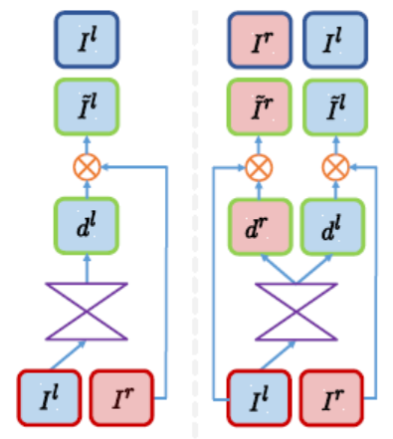

CNN structure
此处插入图片
d : disparity map.
I : Input Image(left or right)
Predict binocular disparity from CNN ,instead of direct predict depth by hand-craft label depth.
Right image act as ground truth.
▲ Unsupervised Monocular Depth Estimation

Slide 6


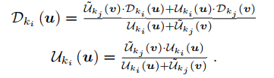
Implementation
Key-frame (use CNN)
Dense depth predict
Pose
Uncertainty map (confidence of depth predict)

Slide 7
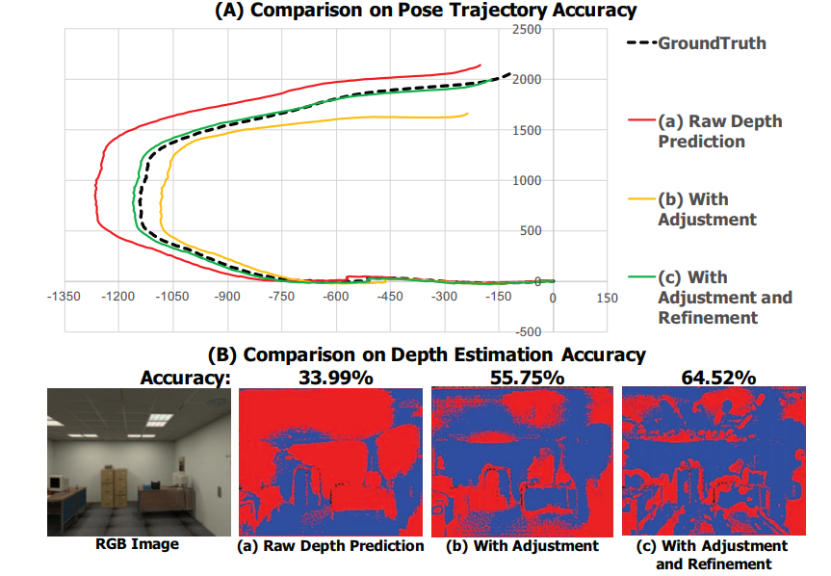

Implementation
Sensor different between slam and training

Slide 8
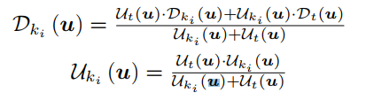
Implementation
Every-frame
Pose (relative to the nearest key-frame)
Only compute high gradient pixel.
Pose graph optimization with G-N algorithm.
Depth
small baseline stereo matching
Uncertainty map
Based on 5-pixel matching along the epipolar line.
Refine the nearest key-frame depth map.
In predict depth, uncertainty is lower in low-texture region.
In depth direct, uncertainty is lower in gradient region.

Slide 9
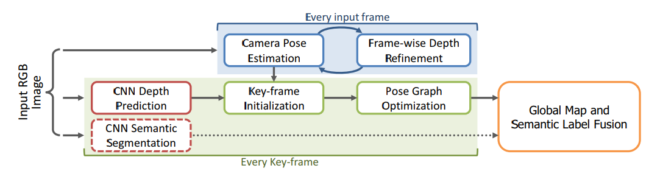
Structure
GPU : for CNN predict to key-frame.
Depth predict
Semantic segmentation
CPU1 : for key-frame
key-frame initial & optimization & semantic fusion
CPU2 : for every frame
pose estimate & refinement

Slide 10
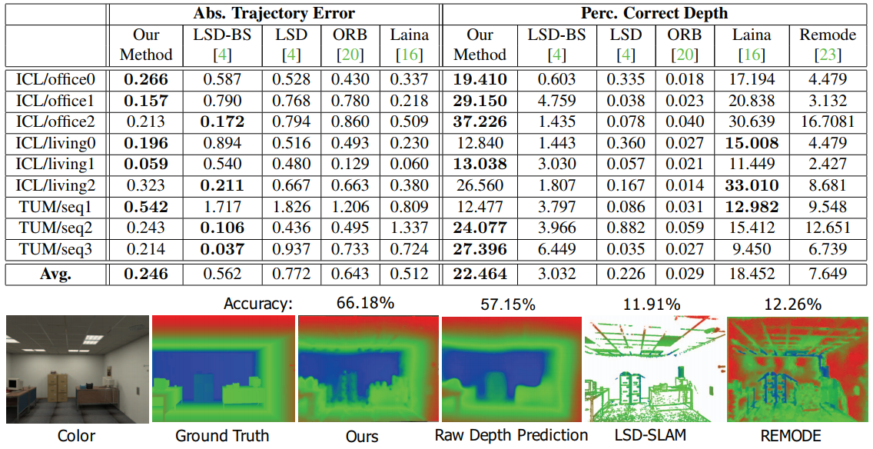
Evaluation

